Slide 1
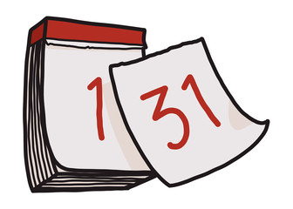



Slide 3


Slide 4


Slide 5

It is………

Slide 6

That’s means Wan Zhen’s birthday is around the corner…..

Slide 7

I should get her a gift…

Slide 8

But.. wait….what should I get for her ??

Slide 9



Ballon or Flower?

Slide 10


Slide 11

then.. how about ….

Slide 12

but maybe she doesn’t have time…..

Slide 13

then what could I give her ??

Slide 14
Aha !!

Slide 15


Slide 16

I’ll send my wishes to her in a different way….

Slide 17

taap.. taap.. taaap…

Slide 18


Slide 19


Slide 20


